Slide 1

Customer Segmentation & Churn Analysis
Understanding our customer & who’s at risk

Slide 2
BACKGROUND PROJECT
Why Customer Segmentation & Churn Analysis?
In today’s competitive market, understanding customer behavior is essential to drive retention and business growth.
Not all customers are the same, segmenting them allows us to tailor strategies based on their unique characteristics and behaviors.
Churn is a major challenge in many industries. Identifying which segments are most likely to leave helps businesses take proactive actions.
This project aims to uncover hidden customer patterns using clustering and explore their relationship to churn behavior.

Slide 3
PROJECT GOALS
Segment customer based on their behaviors
Identify the profile of each segment
Discover which segment is at the highest risk of churn
Provide business insights and recommendations based on segmentation findings

Slide 4
DATASET OVERVIEW
CustomerID | Name | Age | Gender | Annual_Income | Spending_Score | Membership_Level | Purchase_Frequency | Churn_Status
CUST1000 | Connor Rowland | 40 | Female | 52777 | 27 | Gold | 5.2 | 0
CUST1001 | Cameron Miles MD | 28 | Female | 65910 | 84 | Basic | 12.2 | 0
CUST1002 | Dennis Price | 63 | Male | 56731 | 51 | Silver | 2.9 | 1
CUST1003 | Jessica Jones | 23 | Female | 40559 | 56 | Platinum | 11.1 | 0
CUST1004 | Kevin Bauer | 38 | Male | 79675 | 74 | Basic | 10.7 | 0

Slide 5
DATASET OVERVIEW
This dataset has 2000 records with 9 feature.
CustomerID: A unique identifier for each customer
Name: Full name of the customer
Age: Customer’s age
Gender: Gender of the customer
Annual_Income: Approximate annual income in USD,
Spending_Score: A score from 1 to 100 that represents a customer's spending behavior.
Membership_Level: Categorical variable indicating membership type (Basic, Silver, Gold, Platinum).
Purchase_Frequency: Average number of purchases made per month.
Churn_Status: Target variable for classification. 0 means the customer is retained (not churned), 1 means the customer has churned (stopped using the service).
Data source : https://www.kaggle.com/datasets/efeyldz/customer-churn-and-segmentation-dataset-synthetic/data

Slide 6

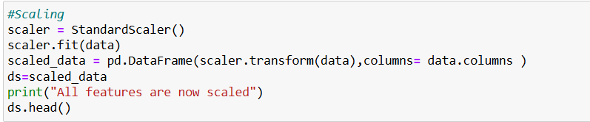
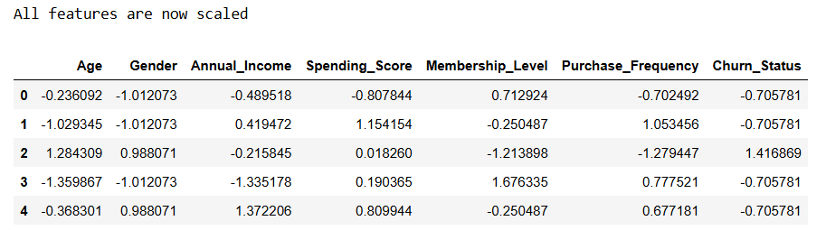
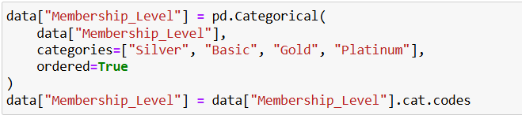


DATA PREPROCESSING
Drop non-informative column: CustomerID & Name
Standardizing numerical features
Encoding categorical variable: Membership level & Gender
Tools

Slide 7
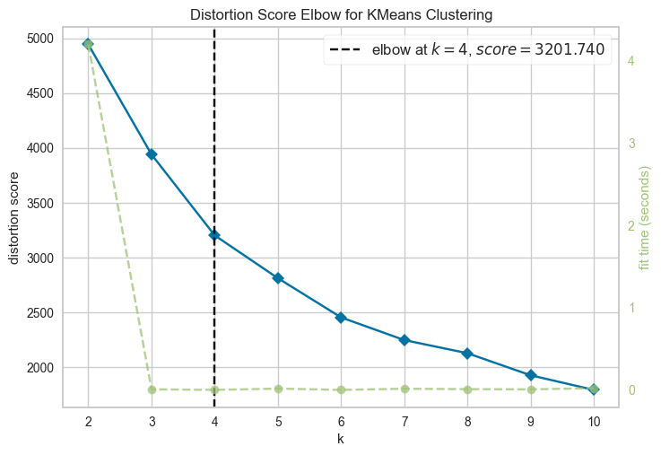
AGGLOMERATIVE CLUSTERING
Determined optimal clusters via Elbow Method
Agglomerative clustering is a bottom-up hierarchical clustering method. It starts by treating each data point as a separate cluster and merges the closest pairs step by step based on a chosen distance metric (e.g., Euclidean) until a desired number of clusters is formed.
Advantages of Agglomerative Clustering:
Effective for small to medium sized datasets
Captures nested data structures
No need to predefine the number of clusters — can be determined using the Elbow Method.
Note: Although Agglomerative Clustering was used as the main algorithm, the optimal number of clusters was estimated using the Elbow Method with KMeans, as Agglomerative does not use centroids.

Slide 8
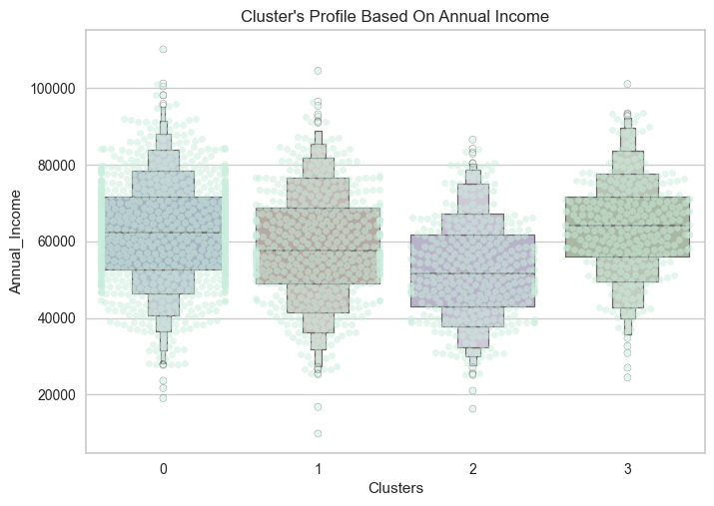
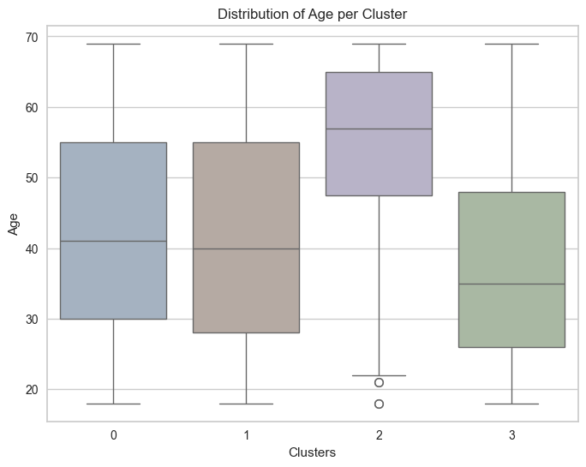
CLUSTER PROFILING
Interpretation: Cluster 0 tends to have a higher median income, while Cluster 2 has the lowest. The overall range is similar, but the distribution patterns vary, indicating different income characteristics within each segment.
Interpretation: Each cluster shows a distinct age distribution, with Cluster 2 skewing older and Cluster 3 skewing younger compared to the others.

Slide 9
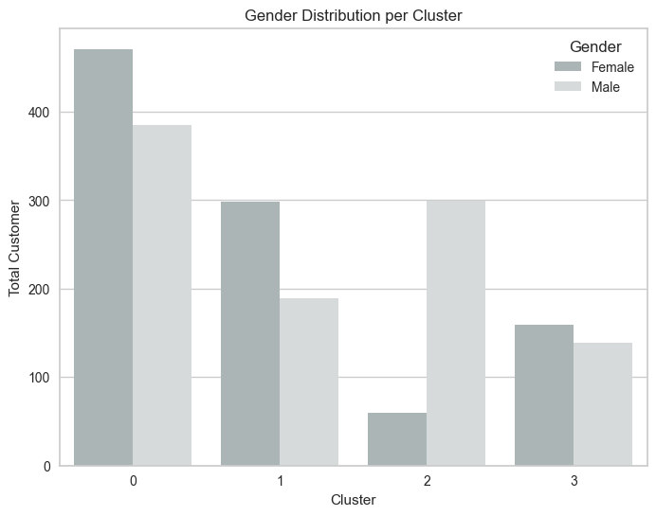
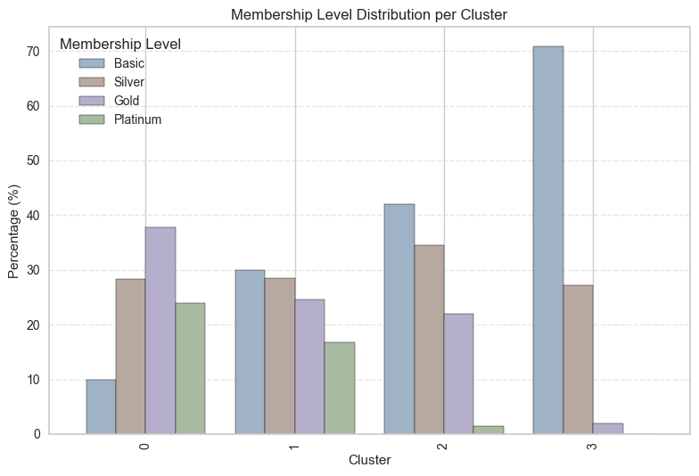
CLUSTER PROFILING
Interpretation: Each cluster shows a distinct gender composition, with notable female dominance in Cluster 0 and male dominance in Cluster 2.
Interpretation: The membership distribution indicates that only Cluster 0 is dominated by Gold members, while the other clusters are mostly composed of Basic members.

Slide 10
Cluster Profiles Summary
Cluster 0: Medium income, predominantly middle-aged individuals, mostly female, and primarily Gold members.
Cluster 1: Medium income, middle-aged group, majority female, and largely Basic member.
Cluster 2: Lowest income among all cluster, mostly between ages 50 to 70, predominantly male, and largely Basic members.
Cluster 3: Medium income, younger segment with a median age around mid-30s, mostly female, and mainly Basic members.

Slide 11
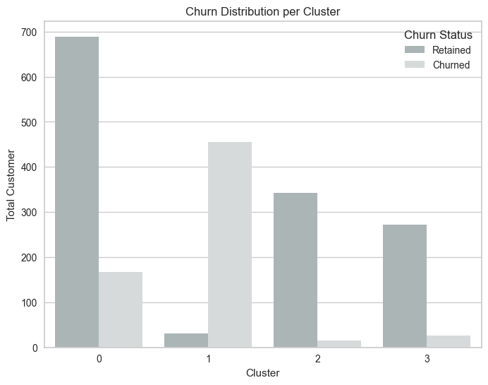
CHURN PER CLUSTER
Most Loyal Segment : Cluster 0
Highest Churn Rate : Cluster 1

Slide 12
BUSINESS INSIGHTS & RECOMMENDATION
🎯Focus Retention Efforts on Cluster 1
🔼Upsell Opportunity in Cluster 2
This cluster has the highest churn rate and consists mostly of women with medium income and Basic/Silver membership levels. Consider targeted loyalty campaigns, personalized engagement, and customer education programs.
Cluster 2 has a low churn rate and is made up of mostly between ages 50 to 70 with stable income and basic membership. Potential to upsell membership tiers or introduce premium offerings.
💎 Maintain Loyalty in Cluster 0
This segment shows high retention, with a significant portion being Gold members. Prioritize exclusive experiences, personalized offers, and rewards to strengthen loyalty.

Slide 13

THANK YOU
Nurfian Dwi Noviani
LinkedIn : www.linkedin.com/in/nurfiandwinoviani
Email : nurfiandwi12@gmail.com

